Slide 1

ShopEase
Sales & Customer Analysis
Analyzing Trends for smarter decisions
Presented By: Vaishnavi Karle
Date: 17-10-2025

Slide 2





What is ShopEase & How does it works
ShopEase is an e-commerce platform that sells a wide variety of products online, including electronics, fashion, home goods and auto accessories. It allows customers to browse, order, and pay online while ensuring fast delivery, easy returns, and customer support.
Workflow:
Browse Products: Customers explore ShopEase’s catalog to find items they want.
Add to Cart & Order: Selected products are added to the cart, and the customer places the order.
Payment: Customers pay online using debit/credit cards, e-wallet, or choose Cash on Delivery (COD).
Order Processing & Shipping: ShopEase prepares the order and ships it to the customer.
Delivery & Returns: Products are delivered to the doorstep; returns or refunds are handled if needed.

Slide 3
Agenda
01
Problem Objective
02
Problem Statement
03
Data Description &
Methodology
04
Key Metrics &
Visualization
05
Dashboard &
Recommendation

Slide 4

Problem Objective
ShopEase aims to make smarter business decisions by using data to improve sales performance, marketing strategies, inventory management, and customer experience.
By understanding product demand, customer behavior, and seasonal trends, the company can boost revenue and enhance overall efficiency.

Slide 5
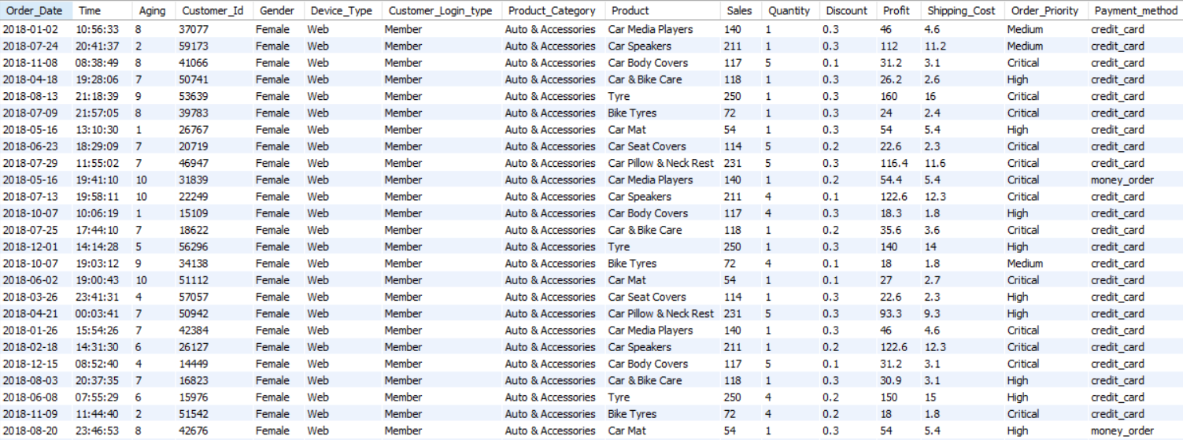
Problem Statement
ShopEase wants to provide fast and personalized online shopping, but its sales and customer data are scattered. Proper analysis is needed to understand trends, optimize inventory, marketing, and improve overall customer experience.

Slide 6
Objective of project
Identify top-selling and underperforming products and categories to optimize inventory and focus on high-demand items.
Understand customer behavior by analyzing patterns based on gender, device type, login type, and payment method to tailor marketing strategies.
Recognize loyal, repeat, and inactive customers to improve engagement and targeted promotions.
Analyze order delays and shipping performance to enhance delivery efficiency and overall customer satisfaction.
Evaluate the impact of pricing, discounts, and customer – paid shipping costs on sales to make data-driven pricing and promotional decisions.

Slide 7
Data Description
order_date – Date when the order was place
order_time – Time when the order was placed
delay – Number of days taken for delivery or delay in shipment
Customer_Id – Unique identifier for each customer
Gender – Gender of the customer
Device_Type – Type of device used to place the order
Customer_Login_type – Method used by the customer to log in
Product_Category – Category of the purchased product
Product – Name of the purchased product
sales – Price of a single unit of the product
quantity – Number of product units purchased
Discount – Discount applied to the order
shipping_cost – Shipping charges for the order
Order_Priority – Priority level assigned to the order
Payment_method – Method used for payment

Slide 8
Data Snapshot
1 . Demographic Data : Customer_Id, Gender
Behavioral Data : Device_Type, Customer_Login_type
Transactional Data : Product_Category, Product, price, quantity, Discount, shipping_cost, Payment_method
Temporal : order_date, order_time
Operational / Logistical : delay, Order_Priority
Total customers | 38992
Total Orders | 51284
Repeat Customers | 10165
Customer_login_Type | Member, Guest, New, First Signup
Average Order Value | 452.06
Average Delivery Days | 5
Min Vs Max Shipping cost | 0.5 / 167.5

Slide 9
Methodology
Data Cleaning:
Tool: SQL(mySQL)
Handled Null and missing values values and clean the data for further analysis.
Performed Data conversion to corrected data types.
Data Analysis:
Tool: SQL(mySQL)
KPIs : Total Revenue, Average Order Value, Retention rate, Churn rate, Average Delivery Days
Key Metrics: Revenue performance
Retention and churn analysis
Customer demographics
Customer Behavior
Product performance
Delivery performance
Measures:
Tool: Power BI(Power query and DAX)
Data Visualization:
Tool: Power BI (Dashboard)

Slide 10
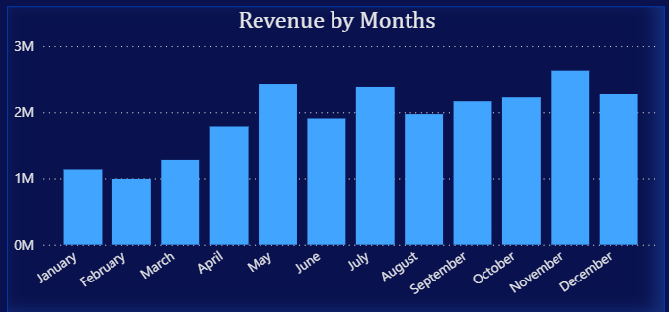
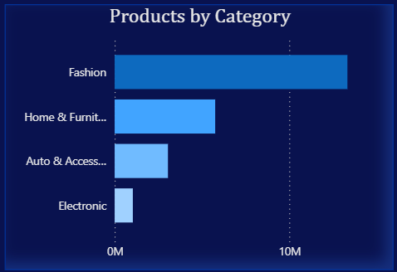
Visualization
Tool : Power BI
Net Revenue by Months
I calculated the net revenue to analyze monthly sales trends. The results show that net revenue peaks in May, July, and November, each crossing 2M, indicating strong seasonal performance during these months. Whereas January and February indicating the lowest sales.
Products by Category
I categorized products to visualize revenue by category. The Fashion category emerged as the top performer, generating over 10M in net revenue, followed by Home & Furniture. On the other hand, Electronics showed the lowest revenue.

Slide 11
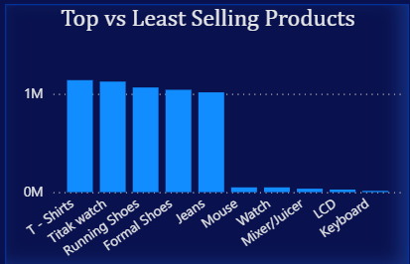
Best-selling Vs Least Selling Product performance
The funnel charts display the highest- and
lowest-performing products.
T-shirts and Watches are among the best-selling products, contributing approximately 1.82M in net revenue.
In other hand, Keyboards underperformed significantly, with revenue of only around 19.34K, indicating weak demand in this category.

Slide 12
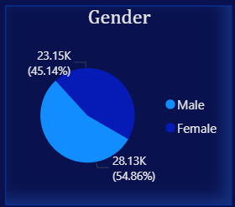
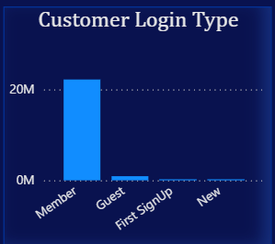
CUSTOMER DEMOGRAPHICS:
Gender
To analyze gender-based sales distribution, I categorized customers by gender. The results show a fairly balanced customer base, with 54.86% male and 45.14% female buyers. This indicates that both genders actively contribute to total sales, allowing balanced marketing strategies.
Customer Login Type
I analyzed customer login types to understand purchasing behavior. Most purchases come from registered members, highlighting strong customer retention and loyalty.
However, very few transactions are from guests or new users, suggesting that there is room to improve customer acquisition strategies.

Slide 13
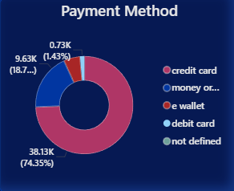
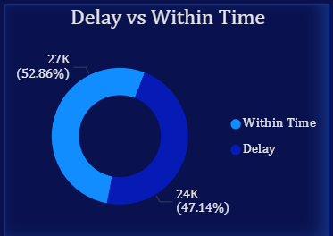
  Payment Method
  A pie chart was created to visualize the preferred payment methods used by customers. The analysis shows that 74.35% of customers used credit cards, making it the dominant payment option. E-wallet and debit card usage remain relatively low, suggesting potential for promoting alternative payment modes.
Delay vs Within time orders
The delivery analysis shows that 52.86% of orders were delivered within the expected time,
while 47.14% experienced delays. This indicates that although more than half of the deliveries meet the target timeline, nearly half still face delays.

Slide 14
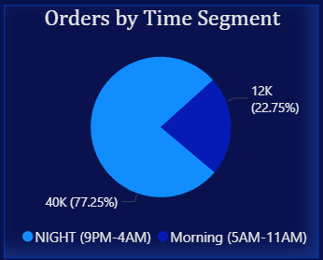
Order by Time Segment
Night-time orders (9 PM–4 AM) dominate with 77.25%, showing a preference for late-hour shopping.
Morning orders (5AM-11AM) with 22.75% are comparatively lower.

Slide 15
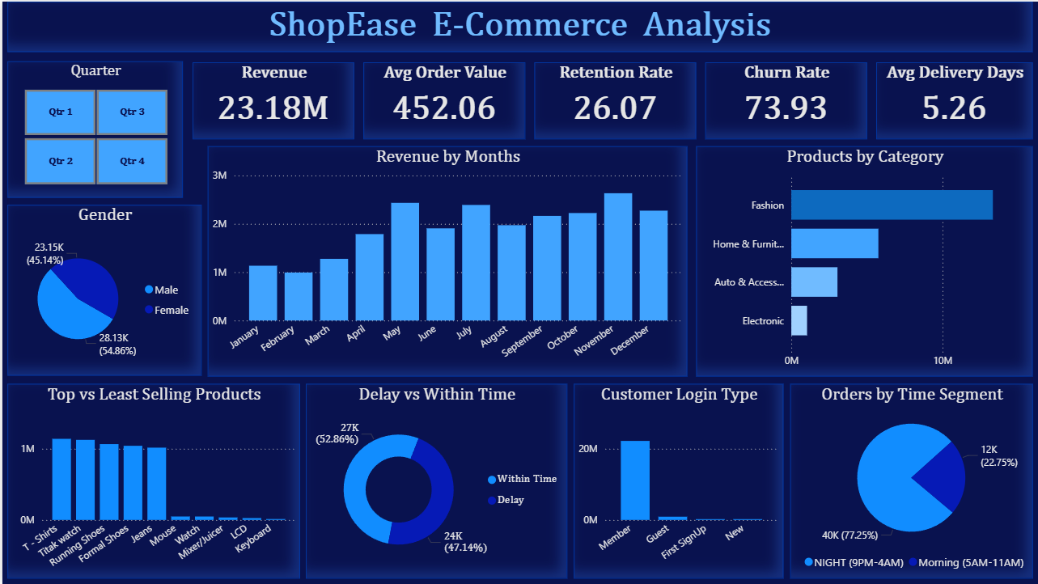
Dashboard

Slide 16
Effective Recommendation
Improve Retention
Use loyalty rewards, personalized offers, and better post-purchase engagement to encourage repeat buying.
Reduce Churn
Fix delivery issues, re-engage inactive customers with targeted offers, and improve overall customer experience.
Improve Delivery Performance:
Should work with reliable delivery partners to reduce delays
Use real-time tracking and warehouse automation to make delivery process faster and smoother.
Low Sales Months:
Offer limited time discounts “Buy 1 Get 1” deals or loyalty points to attract repeat customers.
Increase digital marketing during these months like email campaigns, social media ads or influencer collaborations.
Prepare stock and campaigns early seasonal Peaks for May and November when sales are highest.
Focus on Top Categories:
Continue promoting Fashion and Home & Furniture as they bring in the most sales.
Boost Low-Performing Products:
Reviewing pricing, stock and marketing strategies for weaker products like Keyboard.

Slide 17
Encourage Digital Payments:
Promote e-wallets and debit cards by giving small cashback or reward offers.
Make checkout easier with more payment options.
Increase Customer Growth:
Re-engage inactive customers through personalized emails , offers and reminders.
Offer exclusive discounts for new customers and early access for loyal ones.

